Slide 1
ABC Call Volume Trend Analysis
Final Project-4

Slide 2
PROJECT DESCRIPTION
A Customer Experience (CX) Inbound calling team for 23 days. Data includes Agent_Name, Agent_ID, Queue_Time [duration for which customer have to wait before they get connected to an agent], Time [time at which call was made by customer in a day], Time_Bucket [for easiness we have also provided you with the time bucket], Duration [duration for which a customer and executives are on call, Call_Seconds [for simplicity we have also converted those time into seconds], call status (Abandon, answered, transferred).
APPROACH
I have analyzed the dataset carefully. Observe all the tables, columns, rows. Afterwards check all the report content carefully. Then one by one I have executed ABC call volume trends according to the questions asked.
TECH-STACK USED
Microsoft PowerPoint allows you to create various types of documentation and prepare reports. Microsoft Excel enables users to format, organize, analyze data, and calculate data in a spread sheet, and users can make information easier to view as data is added or changed.
INSIGHTS
I have gained knowledge of various Google sheet functions which helped me to solve the questions asked in this project. The following are the functions I used: Average, Percentage and calculation. I used a pivot table to create charts.
RESULT
By completing the project, I feel more confident in Microsoft Excel knowledge, as this helped me to gain more knowledge about the problem solving to perform better.

Slide 3
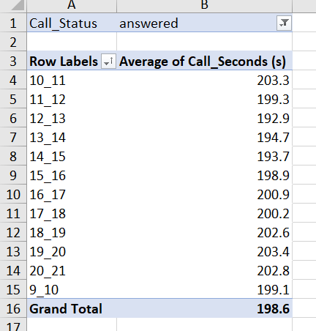
A, Calculate The Average Call Time Duration For All Incoming Calls Received By Agents (In Each Time_bucket).

Slide 4
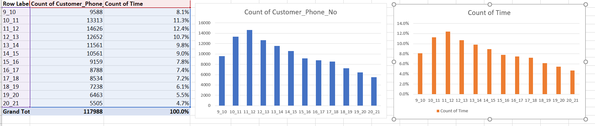
B, Show The Total Volume/ Number Of Calls Coming In Via Charts/ Graphs [Number Of Calls V/S Time]. You Can Select Time In A Bucket Form (I.E. 1-2, 2-3, …..)

Slide 5
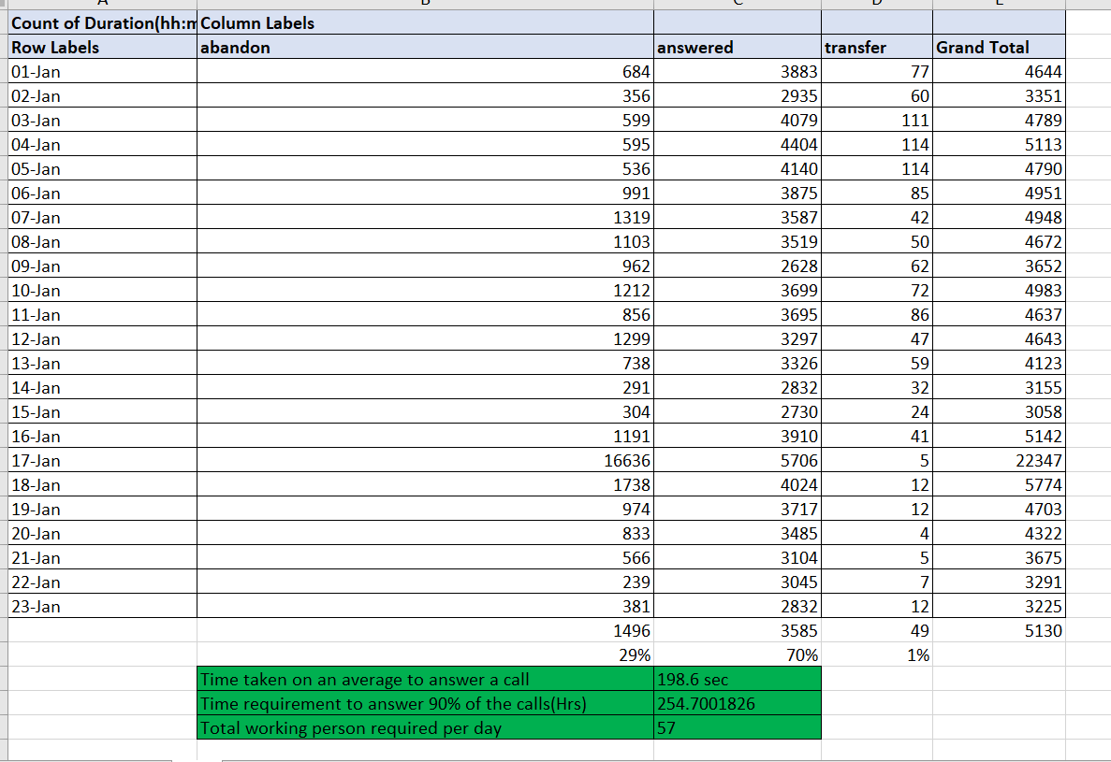
C, As You Can See Current Abandon Rate Is Approximately 30%. Propose A Manpower Plan Required During Each Time Bucket [Between 9am To 9pm] To Reduce The Abandon Rate To 10%.

Slide 6
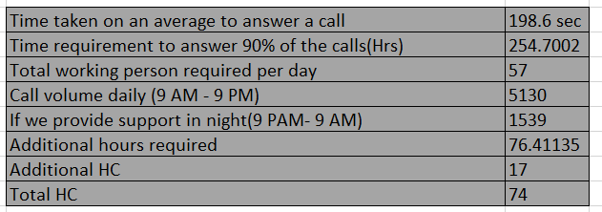
D, LET’S SAY CUSTOMERS ALSO CALL THIS ABC INSURANCE COMPANY IN NIGHT BUT DIDN’T GET ANSWER AS THERE ARE NO AGENTS TO ANSWER, THIS CREATES A BAD CUSTOMER EXPERIENCE FOR THIS INSURANCE COMPANY. SUPPOSE EVERY 100 CALLS THAT CUSTOMER MADE DURING 9 AM TO 9 PM, CUSTOMER ALSO MADE 30 CALLS IN NIGHT BETWEEN INTERVAL [9 PM TO 9 AM] AND DISTRIBUTION OF THOSE 30 CALLS ARE AS FOLLOWS:

Slide 7
THANK YOU
Project Done by
Kaviya

